Slide 1
Residents Association Working Group
01 April 2025
7pm @ the Link
“Introductions”

Slide 2
Agenda
Review Last Meeting
Developer Update
Progress towards Incorporation
Decide on the Name of Association
Decide on the Aims and Objectives of the Association
Decide on the Membership Requirements
Decide on Committee Roles
Develop the Rules of the Association
Promote Membership
Conduct an Inaugural Annual General Meeting (AGM)
Lodge Application
Next Meeting

Slide 3
Review Last Meeting
Minutes from last meeting
The working group’s role is to establish a resident’s association as an incorporated association.
Participation in the working group does not mean that you have volunteered to be involved in the association’s committee.

Slide 4
Developer Update

Slide 5
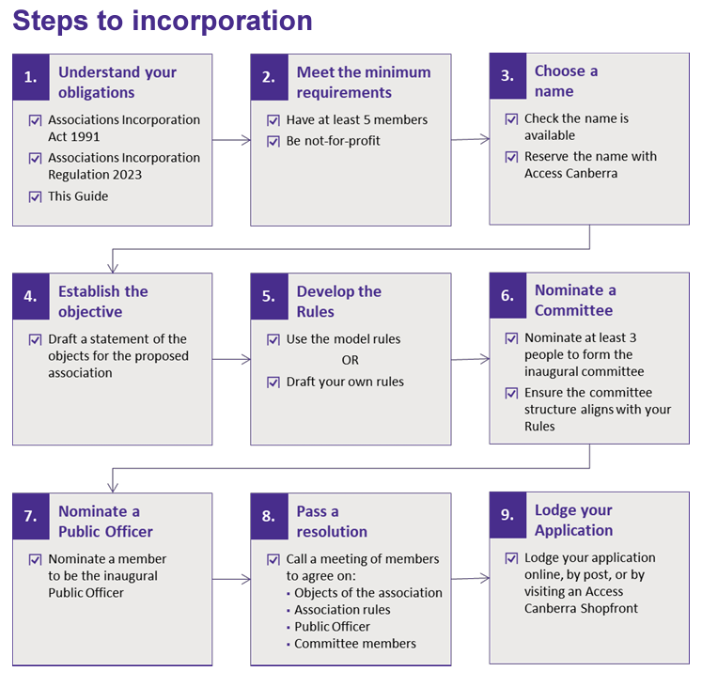
Progress towards Incorporation
  Decide on the Name of Association
  Decide on the Aims and Objectives of the Association
  Decide on the Membership Requirements
  Decide on Committee Roles
  Develop the Rules of the Association
  Promote Membership
  Conduct an Inaugural Annual General Meeting (AGM)
  Lodge Application

Slide 6
Decide on the Name of Association
Ginninderry Residents Association

Slide 7
Decide on the Aims and Objectives of the Association
Build community through inclusive social events and engagement opportunities.
Represent residents by gathering feedback and advocating for their needs and interests.
Strengthen partnerships among all stakeholders to enhance the health and wellbeing of the people and their environment.
Facilitate effective communication by being a central hub for accessible information.
Promote and support community programs and initiatives.

Slide 8
Decide on the Membership Requirements
Types of Membership
  Voting (residents & residential landowners in Ginninderry)
  Non-voting (everyone else aligned with the association’s aims & objectives)
Which memberships have voting rights
  Only the residents and residential landowners of the Ginninderry development.
Membership fees
  Initially nil - to be decided by a vote of the members (General Meeting)
What age can a voting member be?

Slide 9
Decide on Committee Roles
From the Model Rules:
Must include:
  President
  Secretary
  Treasurer
May also Include:
  Vice President
  Ordinary Committee Members
For consideration:
  Representation on the Reference Groups
  Communication
  Events
  Vice Roles
To date the working committee has decided:
no more than one committee member should be allowed per household.
Position holders must possess or complete training requirements associated to their position, as directed by the Committee
positions are voluntary with no remuneration.

Slide 10
Develop Rules of the Association
Model Rules - https://www.legislation.act.gov.au/sl/2023-25
Communications Link

Slide 11
Next Meeting – 7pm, 06 May 2025
Promote Membership
  How to communicate and get people to the AGM and sign up for membership
Conduct an Inaugural Annual General Meeting (AGM)
  When?
Lodge Application
WhatsApp Group & Email List

Slide 12
Out of Scope for Working Group
Tasks for Committee, once established:
  Training for Committee Members
  Bank Accounts
  Budgets
  Data security and privacy policy

